Slide 1



Our Academy Vision
‘Inspiring All to Excellence’
At Violet Way Academy we want all of our pupils to ‘Reach for the Stars’. This means setting aspirational goals, persevering in the face of challenge and striving for excellence in all that they do.
"Over the last two decades, there has been a deepening recognition of the fundamental importance of improving reading standards on a child’s future academic achievement, wellbeing and success in life."
DfE The Reading Framework
(July 2021)

Slide 2

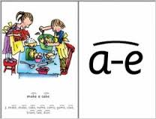
Sound cards
Children learn new sounds weekly using Read Write Inc Phonic sound cards.
These have the sound on one side and a picture and a rhyme on the other to help support the children to remember to correct sound.
When there are 2 or more letters together to make a sound we call these ‘special friends’.
Set 1 teaches initial sounds then ch sh th ng nk ll ck ss ff zz mp
Set 2 teaches the most common ‘special friend sounds’
ay ee igh ow oo oo ar ir or ou oy
Set 3 and Set 4 then teach additional ‘special friends’ and alternative sounds for the Set 2 graphemes.

Slide 3

How to say the sounds – a Guide for Parents

Slide 4
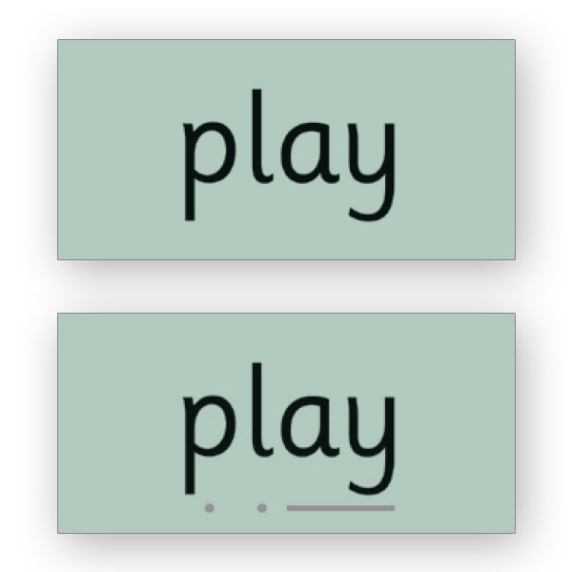
Green Words
Once the children learn the first 5 sounds - m a s d t they start to sound out, blend and read words.
Children read words on green cards that we call Green Words because they can use their phonic knowledge to sound them out.
There are green word cards that match each of the sounds that the children learn so that they can practise reading words with their new sound in.
These sound cards use sound buttons . for a single sound _____ for special friends to help the children read these words.
On the other side of the card is the same word without the sound buttons so that children can become more fluent readers and less reliant on the sound buttons for support.

Slide 5

Red Words
Red words or tricky words are words that children can not phonetically sound out using the sounds that they have learnt in Set 1, 2,3 or 4.
There are red words for all of the different book levels in Read Write Inc that children have to practise reading to know these from sight without any sounds out at all.
To become a fluent reader reading these is as important as knowing all of the phonic sounds and being able to read Green words.
Children will bring home the red words for the level Read Write Inc book they are on to practise at home in Rocket Reader books.

Slide 6

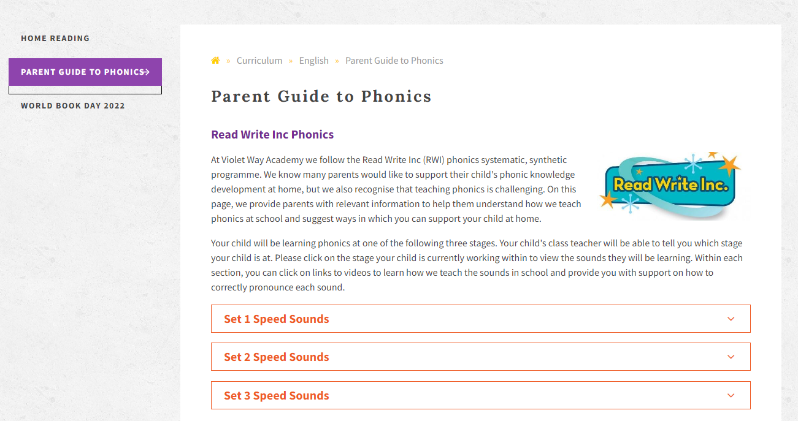
Further Information
Further information about Read Write Inc and how we teach Phonics and Reading at Violet Way can be found on our website:
www.violetway.org

Slide 7
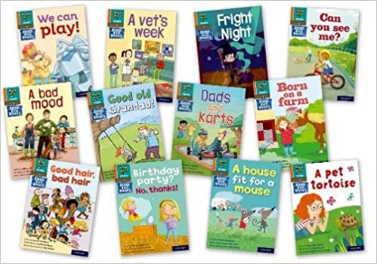
Reading at Home
For all of the different Read Write Inc Book levels that we have in school there are Read Write Inc Book Bag Books that will be sent home with children to match. These will have phonic sounds from the same set that children will be reading in class and will also have the same red words. Please read this book more than once with your child to develop fluency and expression and please read as many nights as you can at home to support your child’s reading development.

Slide 8
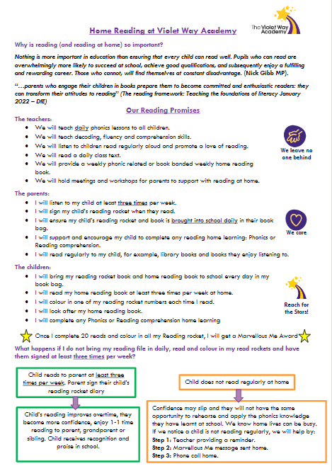

Slide 9

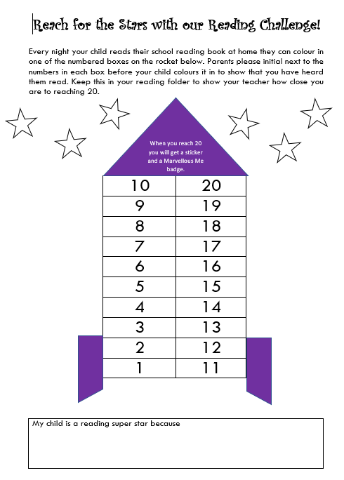
Reading Rocket Books
All children have a Reading Rocket book in their reading file. Every time your child reads you can initial a box on their rocket and the children can colour in the number to show how many reads they have completed.
These are checked weekly by class teachers. Once the children reach 20 reads they get a sticker and a Marvellous Me badge before starting again with a new rocket.
Your child’s reading file with their Reading Rocket book and their home reading book must always be put back into book bags after reading at home and brought into school daily.

Slide 10


Slide 11
Reading at Home Top Tips
Make reading part of your regular routine at home – have a quiet place or a calm time of the day to do it.
Don’t try to get children to read their book last thing at night when they are tired or if you are in a rush.
Check for understanding as well as fluency. Answer the questions that can be found in the back of the books.
Make it an enjoyable experience that you do together. Play games like fastest finger to point to certain red words or words with phonic sounds in.
Break up reading by reading a page each. Children read with a partner during Read Write Inc so are used to this but also means they get to hear you modelling what a good reader sounds like.

Slide 12
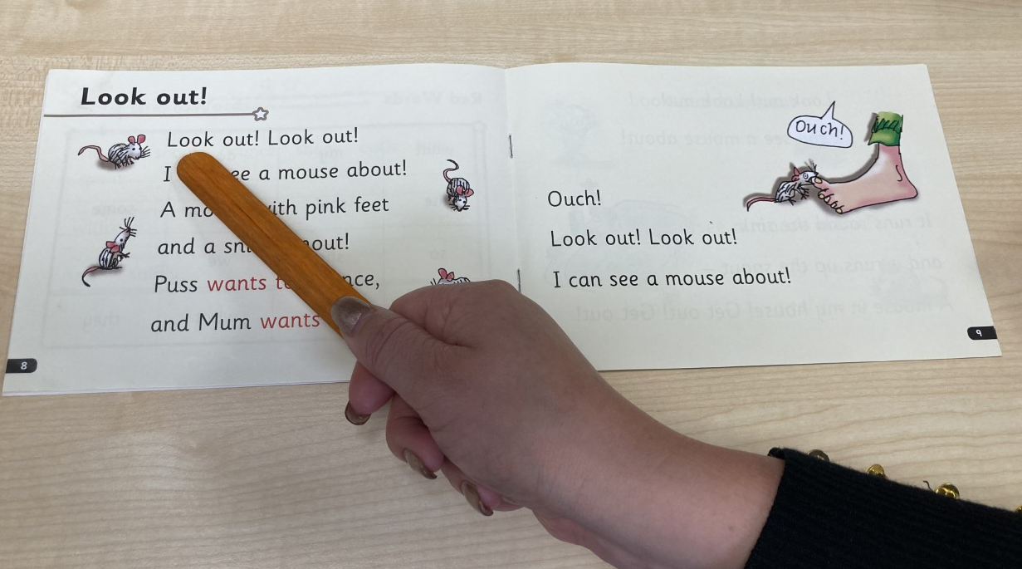
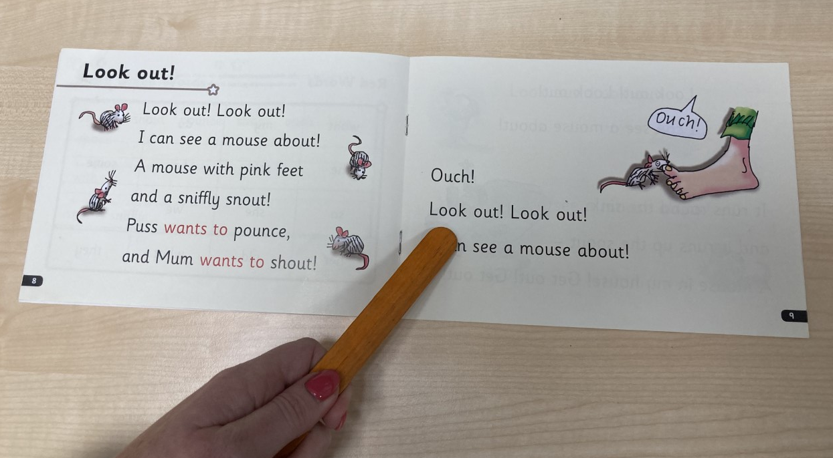
Reading in pairs at home and at school

Slide 13

How to support Reading at Home

Slide 14

Reading at Home
The children have brought home a login for Oxford Owl ebook Library. This can be accessed on www.oxfordowl.co.uk and children will have their own login and password. This allows them access to additional Read Write Inc books that they can read online at home. Their teacher will select the Read Write Inc book that they have read in class the previous week so they can read it again at home for further support and development of their reading and phonic skills.

Slide 15
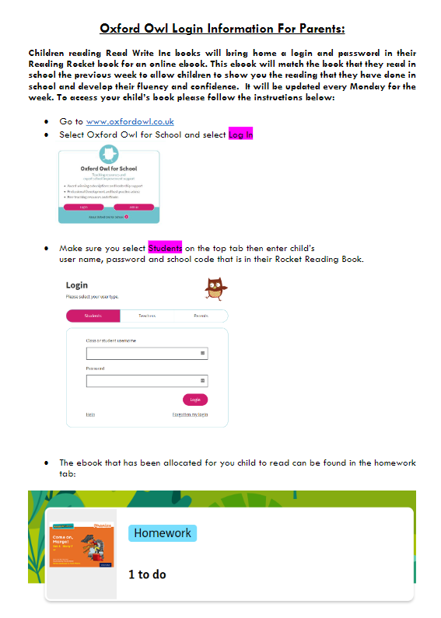
Oxford Owl ebooks for RWI
Log Ins to Oxford Owl
Select Homework Tab
Book for the week will be there for children to read
Guide sent out on
Marvellous Me

Slide 16

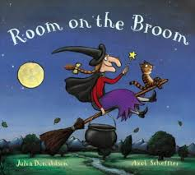

Reading for Pleasure
Reading for pleasure is extremely important. Children need to have opportunities to hear stories being read to them as well as reading books themselves. Each class has a daily story time with one visit to our school library each week. We also have Parent Library Mornings and children can take a library book from school home weekly too. These books are ones of the child’s choice – they may be books that they can read themselves but they may also be books that you need to read to them. They may also bring a book home that they have previously brought home before.
Year 2 have library on Wednesday mornings and Year 1 on Thursday mornings.

Slide 17
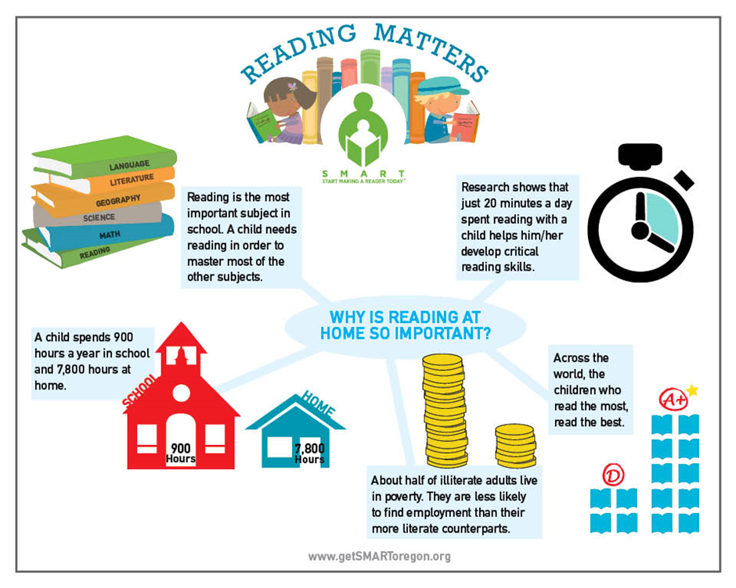
Why is reading to my child and listening to my child read at home so important?

Slide 18


Why is reading to my child and listening to my child read at home so important?

Slide 19

Any Questions?

